Slide 1
Deep Learning

Slide 2
Last Lecture: Secret of SVM popularity
At their core, SVMs are simple linear classifiers, but:
Soft-margin learning allows for outliers – not “brittle” like perceptron learning
Well-principled, easy to understand learning – less likely to fall into local minima
Many applications have high dimensional feature spaces with redundancy – linear classification works okay
Fast – classification is just a dot product, basic learning also fast (but gets complicated with kernels, slack variables, huge datasets, high dimensionality)
Kernel trick – allows trade-off between strength of model and danger of overfitting

Slide 3
Image Classification with Neural Networks
P(img=dog)
P(img=cat)
P(img=bunny)
Resize image to a fixed size
Concatenate pixels into 1xn vector
x₁, …,x_{n}
z₁, …,z_{m}
y₁, …,y_{n}

Slide 4
Image Classification with Neural Networks
P(img=dog)
P(img=cat)
P(img=bunny)
3 layer NN = universal approximator → given enough neurons in the hidden layer, this should work
But it usually does not work (for more complex problems)
Why?
General concept (dog vs. cat vs. bunny) very hard to extract
Simple vector is not a good representation
Unclear how many hidden neurons (and how many images) are needed for successful training

Slide 5
What to do?
SVM
Neural Network
Random Forest
…
Image/ Video
Pixels
Hand-designed feature extraction
Trainable classifier
Object Class
Spend a lot of research effort into building image representations that better capture the concept (dog vs. cat) and turn those into a vector
Color histograms
Feature points
Scale-invariant descriptors (SIFT, HOG, SURF,…)
Visual word clustering
…
R G B
R G B

Slide 6
“Shallow” vs. “deep” learning
“Shallow” architecture
Image/ Video
Pixels
Hand-designed feature extraction
Trainable classifier
Object Class
Deep learning: “Deep” architecture
Image/ Video
Pixels
Layer 1
Layer N
Simple classifier
…
Object Class
Slide credit: Rob Fergus

Slide 7
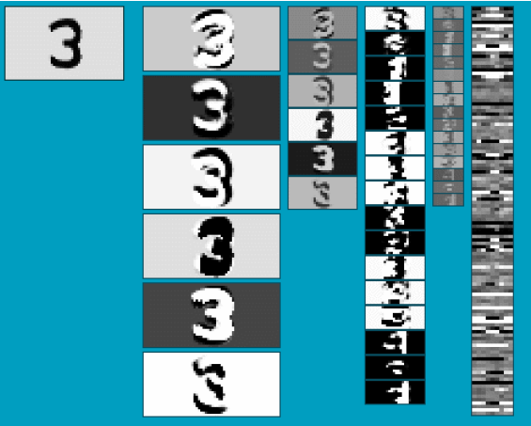
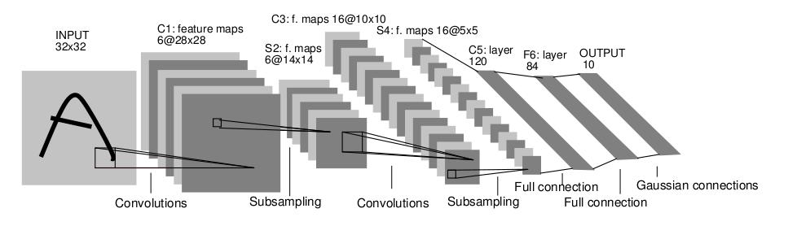
Convolutional Neural Networks
Neural network with specialized connectivity structure
Stack multiple stages of feature extractors
Higher stages compute more global, more invariant features
Classification layer at the end
Slide credit: Rob Fergus

Slide 8
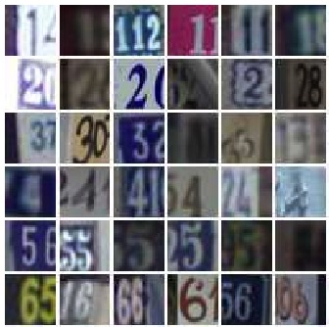
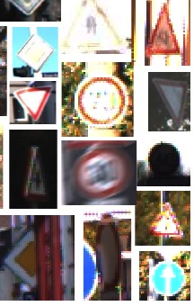
Convnet Successes
Handwritten text/digits
MNIST (0.17% error [Ciresan et al. 2011])
Arabic & Chinese [Ciresan et al. 2012]
Simpler recognition benchmarks
CIFAR-10 (9.3% error [Wan et al. 2013])
Traffic sign recognition
0.56% error vs 1.16% for humans [Ciresan et al. 2011]
But until recently, less good at more complex datasets
Caltech-101/256 (few training examples)
Slide credit: Rob Fergus
Notes:
CIFAR-10, 60.000 images, 10 classes

Slide 9
ImageNet Challenge 2012
~14 million labeled images, 20k classes
Images gathered from Internet
Human labels via Amazon Turk
Challenge: 1.2 million training images, 1000 classes
[Deng et al. CVPR 2009]
Slide credit: Rob Fergus
Notes:
Area of big data!

Slide 10
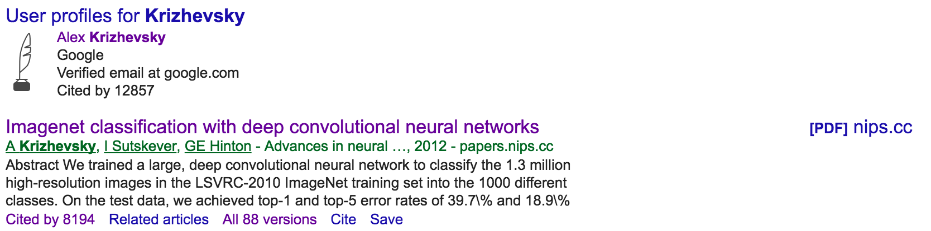
ImageNet Challenge 2012
Krizhevsky et al. -- 16.4% error (top-5)
Next best (non-convnet) – 26.2% error
Slide credit: Rob Fergus
Notes:
- AlexNet

Slide 11
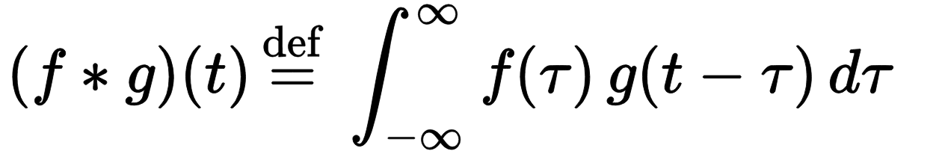
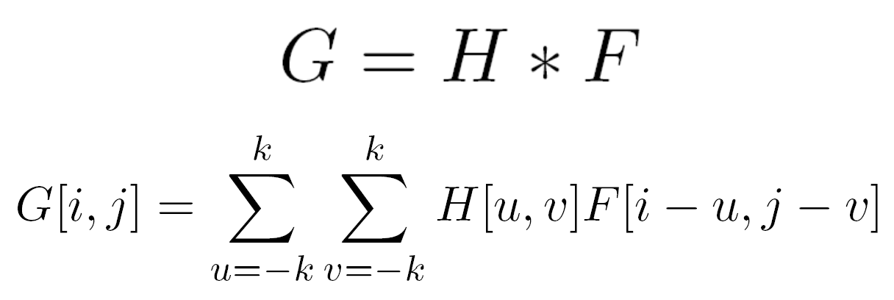
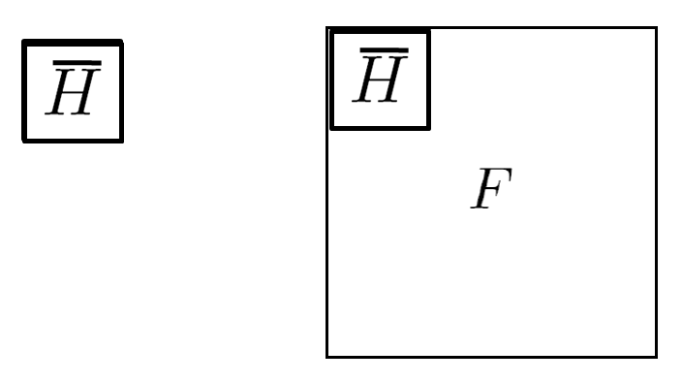
So what’s a Convolution?
A simple way to think of this is a filter, where the signal g is filtered with some filter f
Discrete convolution:
We can filter images to get a new image (or filter response)!
Notes:
- AlexNet

Slide 12
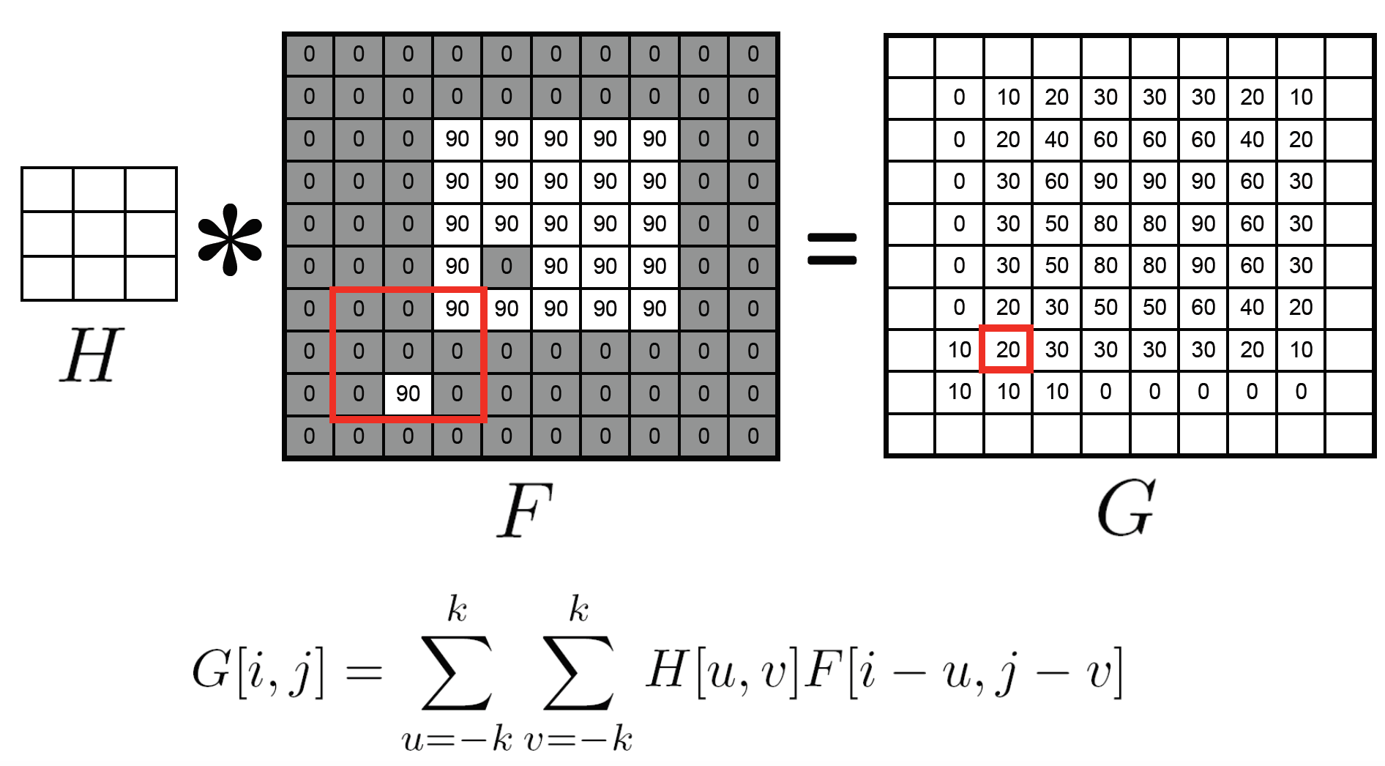
Simple Example: Mean Filtering
1/9 1/9 1/9
1/9 1/9 1/9
1/9 1/9 1/9
Notes:
- AlexNet

Slide 13
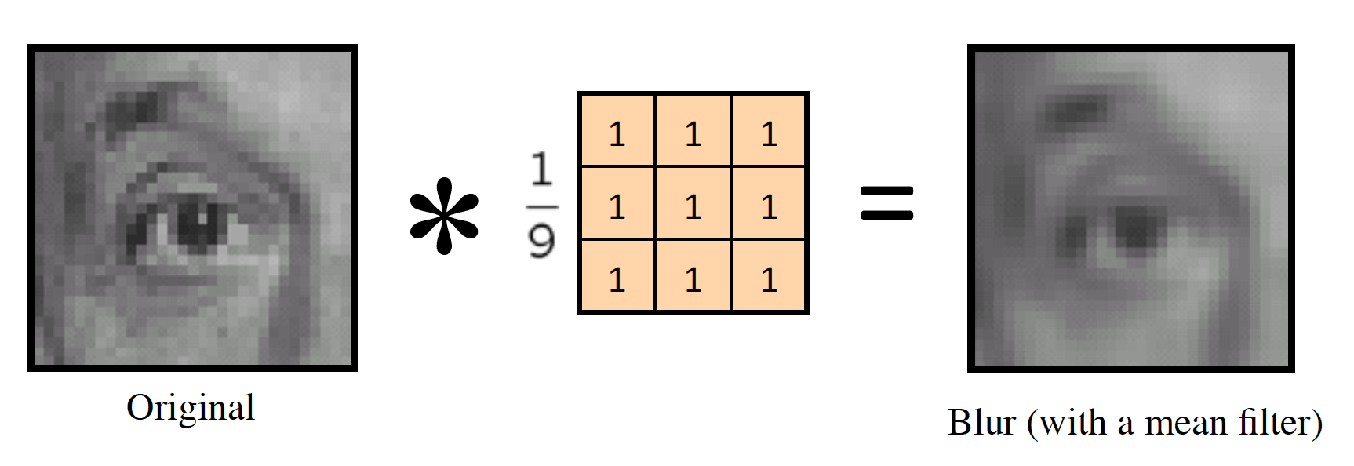
Simple Example: Mean Filtering
Notes:
- AlexNet

Slide 14
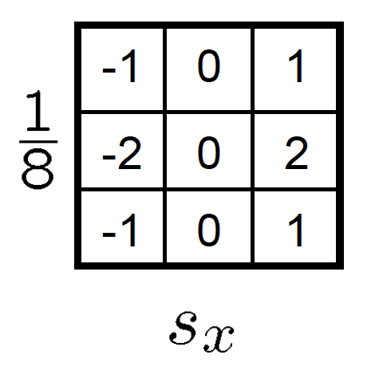
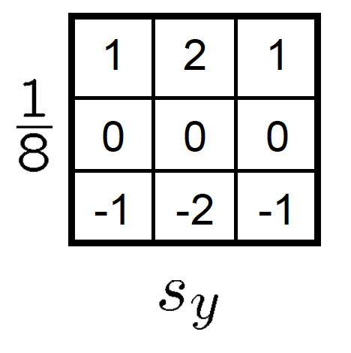
More Interesting Example: Edge Detection
Core Inside: We can build filters that highlight (extract) specific patterns in the image!
In this example: edges in horizontal or vertical direction
Notes:
- AlexNet

Slide 15
Neural Networks can implement Convolutions!
Where:
w₁ = w₁ = w₁ = w₁,
w₂ = w₂ = w₂ = w₂,
w₃ = w₃ = w₃ = w₃,
w₄ = w₄ = w₄ = w₄
Weights correspond to the filter (kernel) values
Neural networks can learn their own filters!
Notes:
- AlexNet

Slide 16
Convolutional Neural Networks
Neural network with specialized connectivity structure
Stack multiple stages of feature extractors
Higher stages compute more global, more invariant features
Classification layer at the end
Slide credit: Rob Fergus

Slide 17
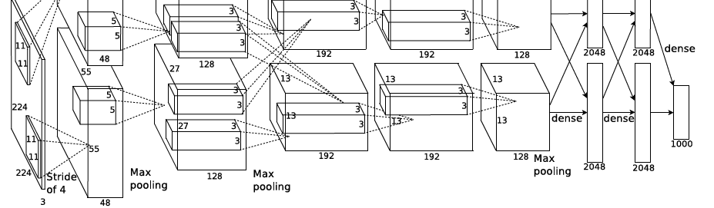
ImageNet Challenge 2012
Similar framework to LeCun’98 but:
Bigger model (7 hidden layers, 650,000 units, 60,000,000 params)
More data (10⁶ vs. 10³ images)
GPU implementation (50x speedup over CPU)
Trained on two GPUs for a week
Better regularization for training (DropOut)
A. Krizhevsky, I. Sutskever, and G. Hinton, ImageNet Classification with Deep Convolutional Neural Networks, NIPS 2012
Notes:
Two-GPU architecture

Slide 18
Convolutional Neural Networks (CNN, Convnet)
Feed-forward feature extraction:
Convolve input with learned filters
Non-linearity
Spatial pooling
Normalization
Supervised training of convolutional filters by back-propagating classification error
Feature maps
Normalization
Spatial pooling
Non-linearity
Convolution (Learned)
Input Image

Slide 19
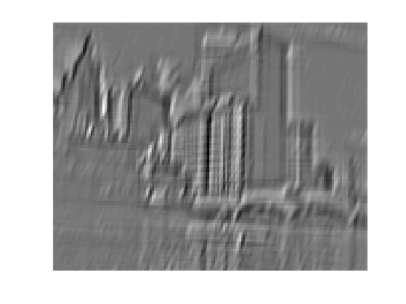


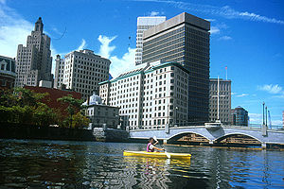
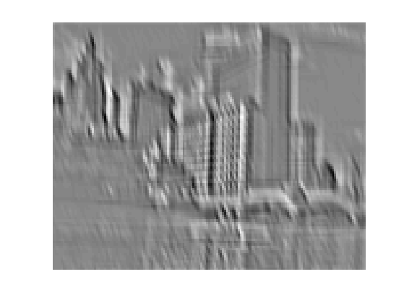
1. Convolution
Dependencies are local
Translation invariance
Few parameters (filter weights)
Stride can be greater than 1 (faster, less memory)
...
Input
Feature Map

Slide 20
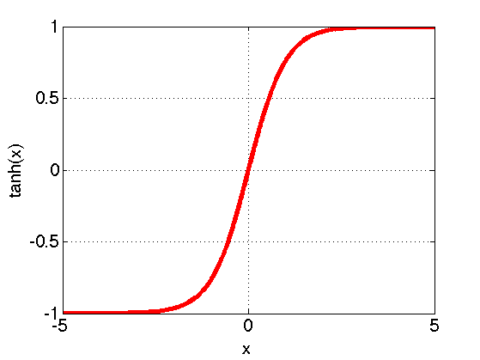
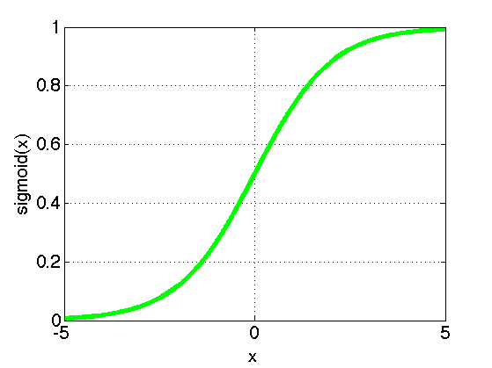
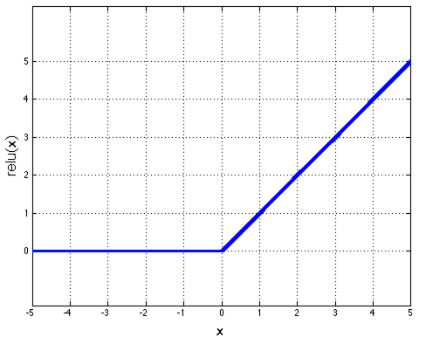
2. Non-Linearity
Per-element (independent)
Options:
Tanh
Sigmoid: 1/(1+exp(-x))
Rectified linear unit (ReLU)
Simplifies backpropagation
Makes learning faster
Avoids saturation issues → Preferred option
Slide credit: Rob Fergus

Slide 21
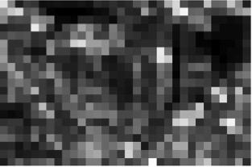
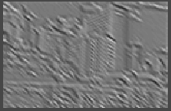
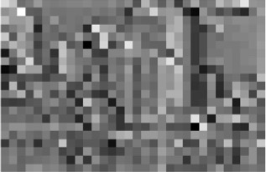
3. Spatial Pooling
Sum or max
Non-overlapping / overlapping regions
Role of pooling:
Invariance to small transformations
Larger receptive fields (see more of input)
Max
Sum
Slide credit: Rob Fergus

Slide 22
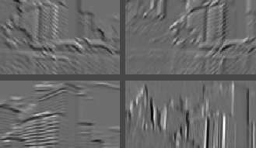
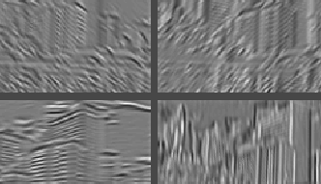
4. Normalization
Within or across feature maps
Before or after spatial pooling
Feature Maps After Contrast Normalization
Feature Maps
Slide credit: Rob Fergus

Slide 23
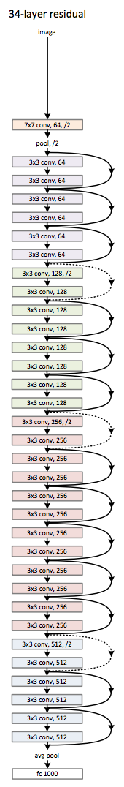
Well-Known Networks
AlexNet (2012)
ResidualNets (2015)

Slide 24
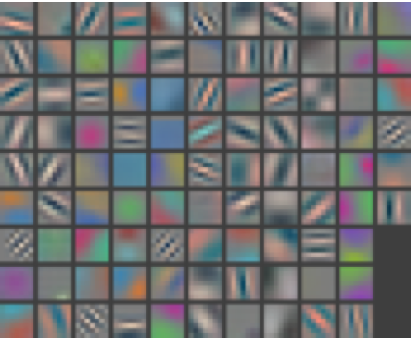
What does each layer learn?
Layer 1 Filters

Slide 25
What does each layer learn?
Layer 1: Top-9 Patches for each Filter

Slide 26
What does each layer learn?
Layer 2: Top-9 Patches for each Filter

Slide 27
What does each layer learn?
Layer 4: Top-9 Patches for each Filter

Slide 28
What does each layer learn?
Layer 5: Top-9 Patches for each Filter

Slide 29
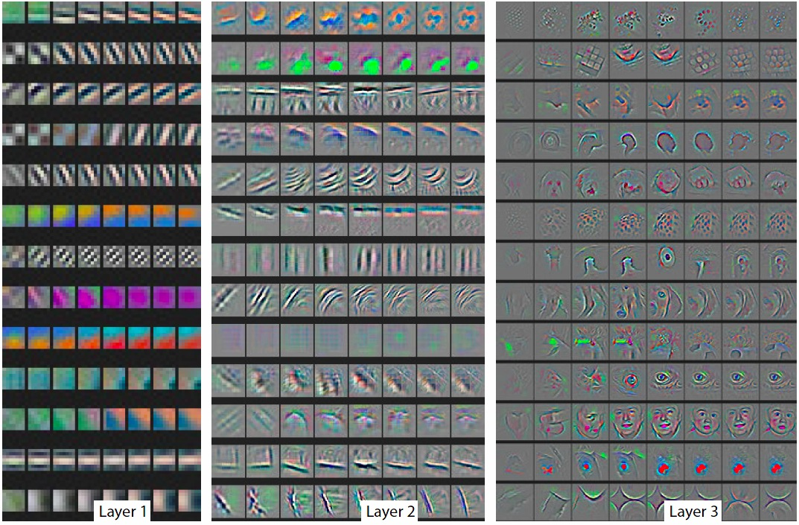
Filter Reconstructions

Slide 30
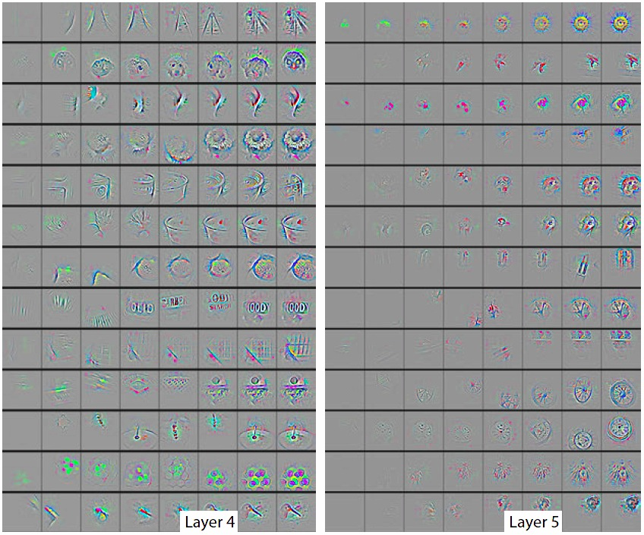
Filter Reconstructions

Slide 31
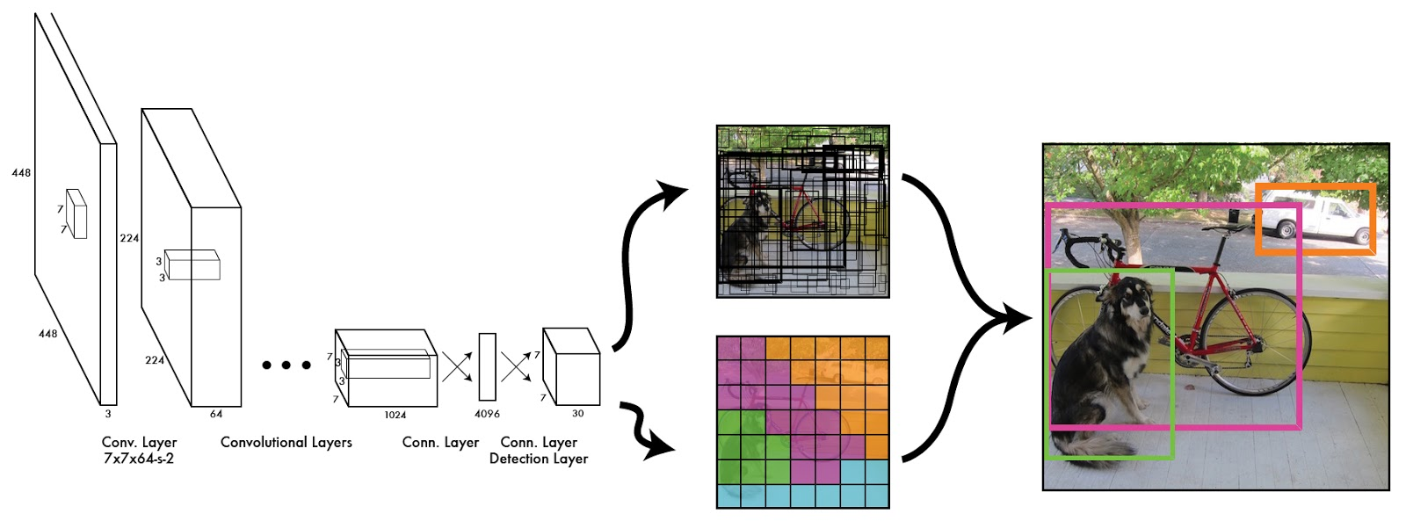
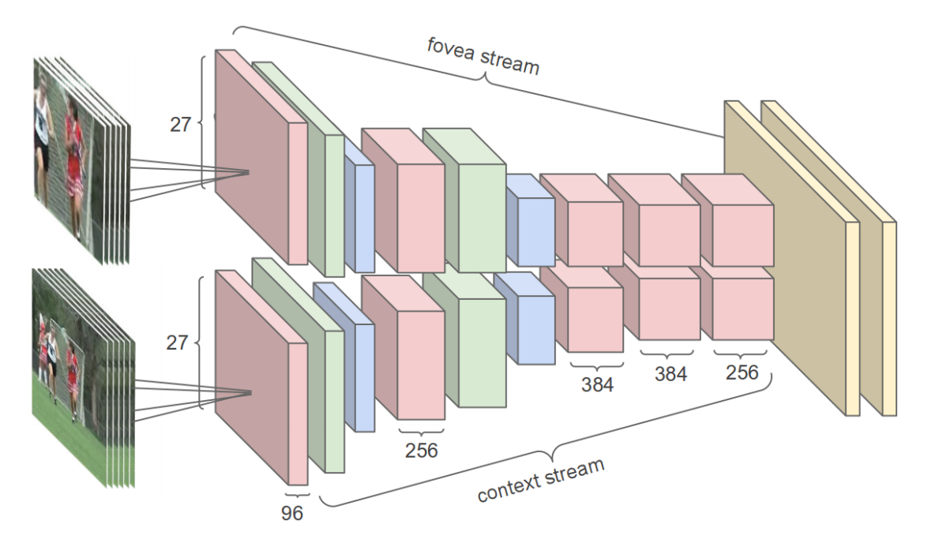
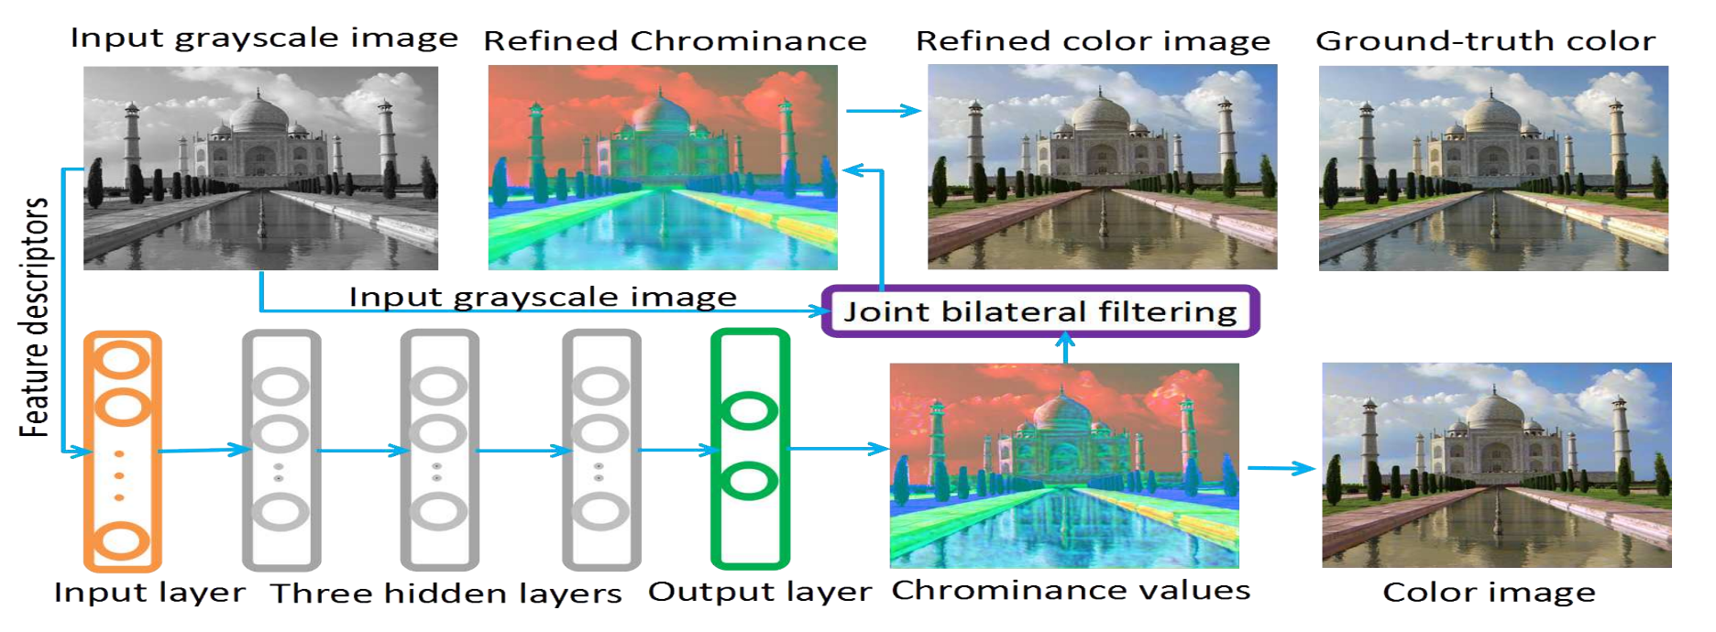
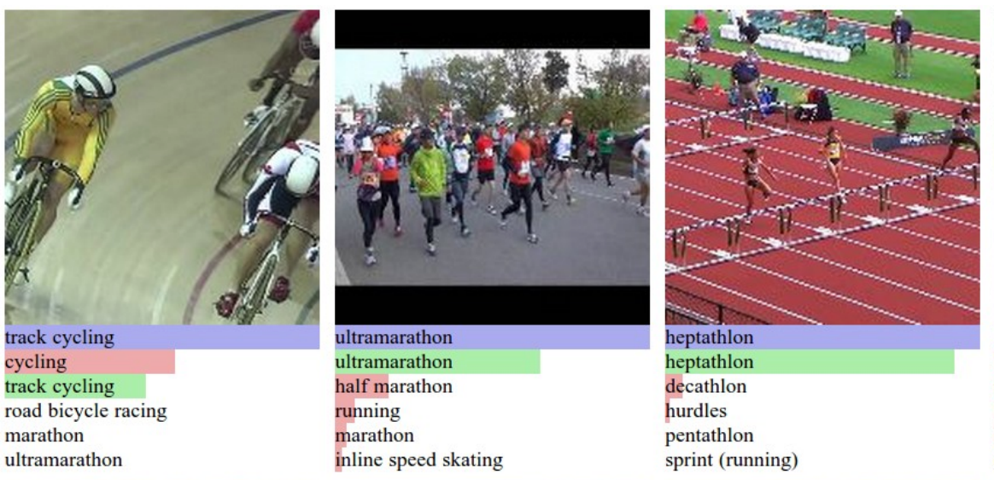
Beyond Classification
Redmon et al. 2016
Jong et al. 2015
Semantic Segmentation
Object Detection
Karpathy et al. 2014
Image colorization
Cheng et al. 2015
Video / Action Recognition
Notes:
Recipe:
Good architecture
Good loss function (regression, classification)
Lots of labled data
End-to-end Training

Slide 32
Beyond Classification
Redmon et al. 2016
Jong et al. 2015
Semantic Segmentation
Object Detection
Karpathy et al. 2014
Image colorization
Cheng et al. 2015
Video / Action Recognition
Notes:
Recipe:
Good architecture
Good loss function (regression, classification)
Lots of labled data
End-to-end Training

Slide 33
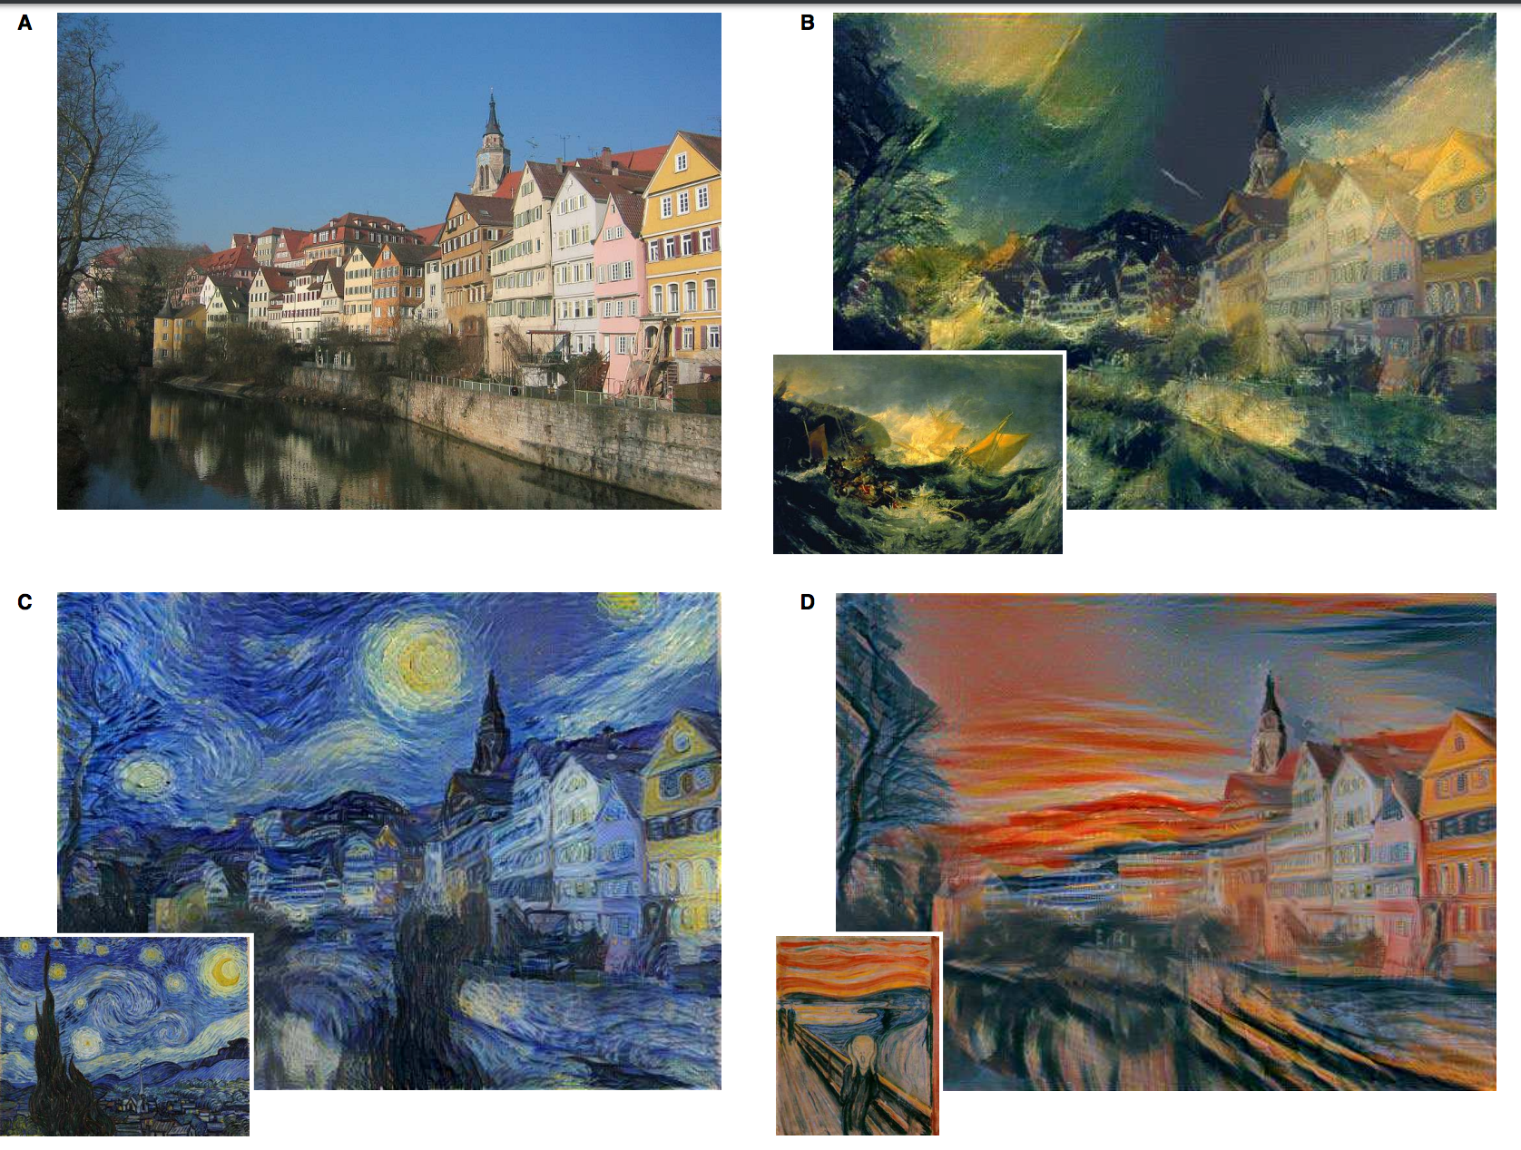
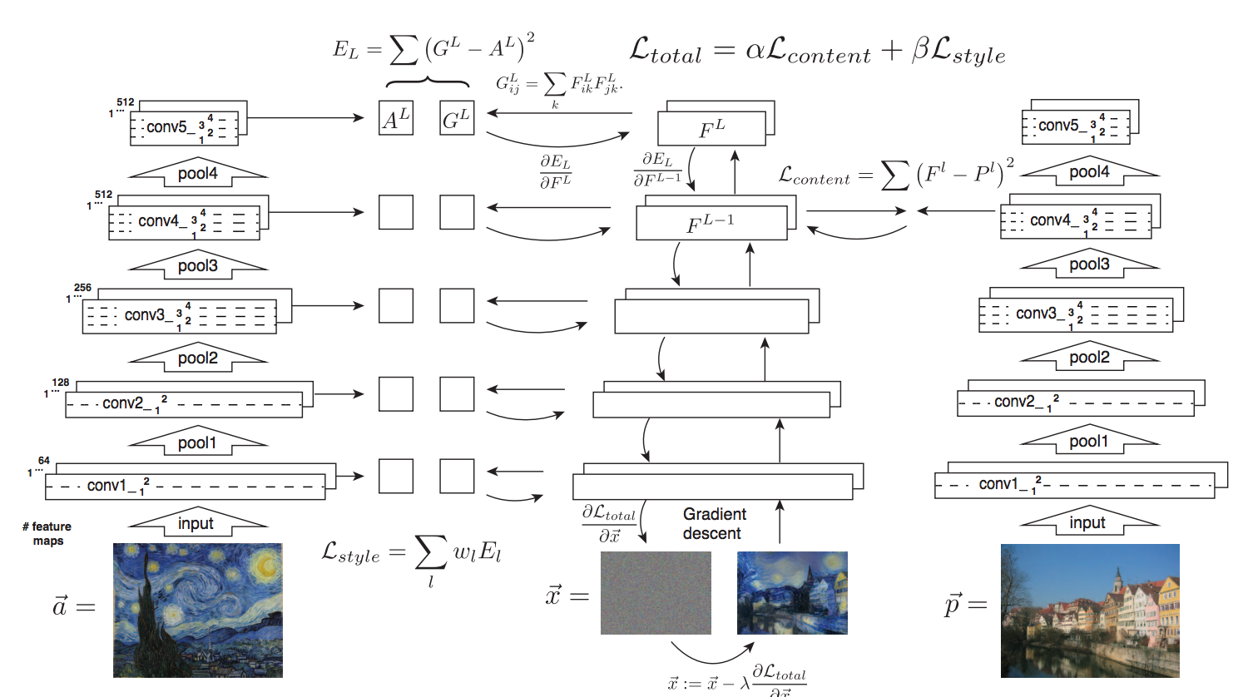
Beyond Classification
Gatys et al. 2015
Image style transfer
Notes:
Recipe:
Good architecture
Good loss function (regression, classification)
Lots of labled data
End-to-end Training

Slide 34
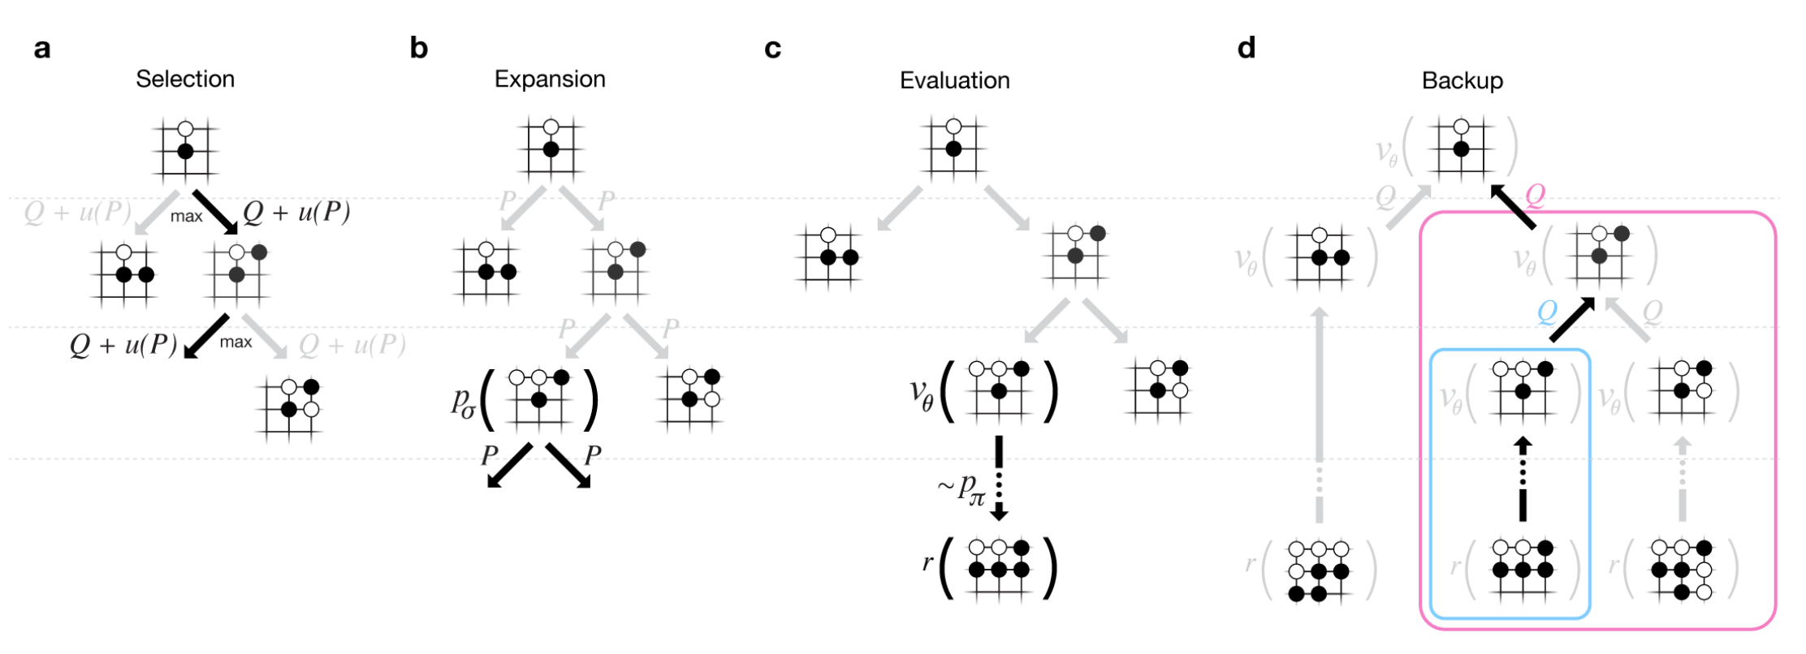
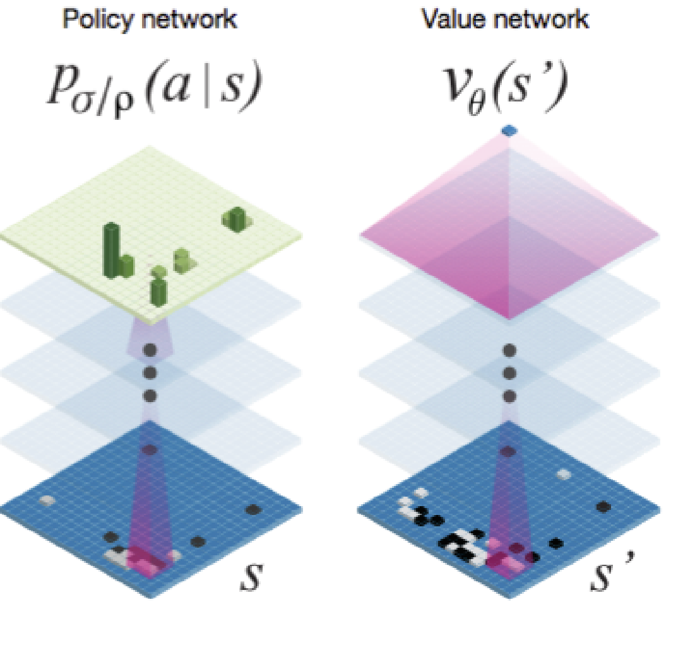
Beyond “Vision” (1)
Alpha Go
Very sophisticated mixture of tree search and CNNs:
The Game of “Go”
Board size: 19x19
Average branching factor: 250
State space: 10^170
Silver et al. 2016
Notes:
More than one googl (10^100)
CNN: Good to extract complex patterns from multidimensional data, end to end trainable such that extraction is optimized with respect to goal

Slide 35
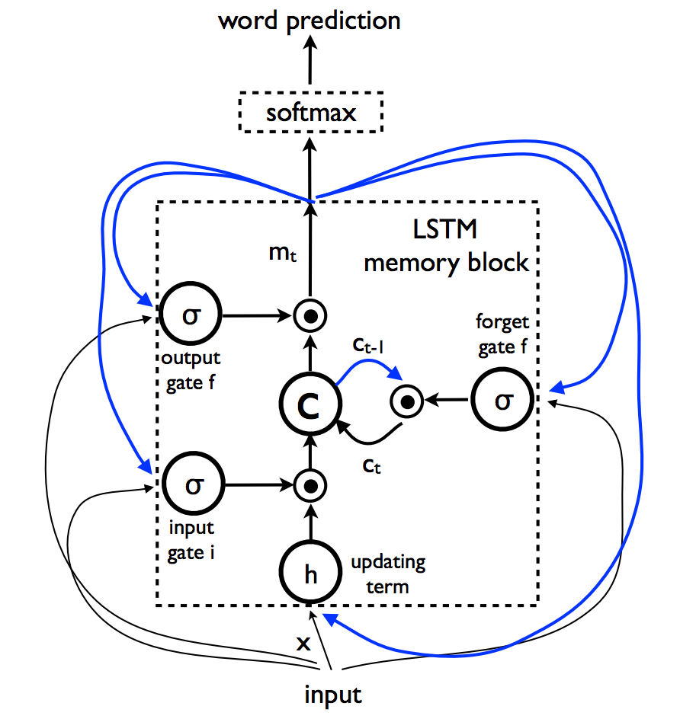
Recurrent NNs
So far we’ve looked at feed-forward nets.
Recurrent neural networks include “feedback loops”
E.g. Long short-term memory networks
Useful for learning and predicting sequences, e.g. translations from one language to another
LSTM unit
Notes:
Long Short Term Memory

Slide 36
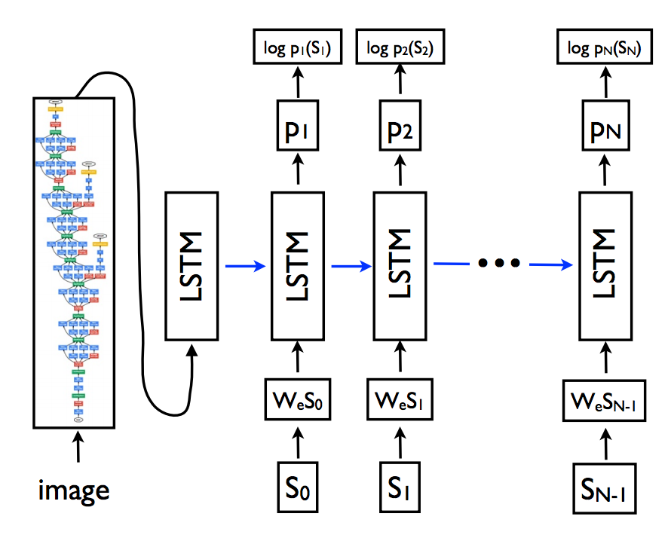
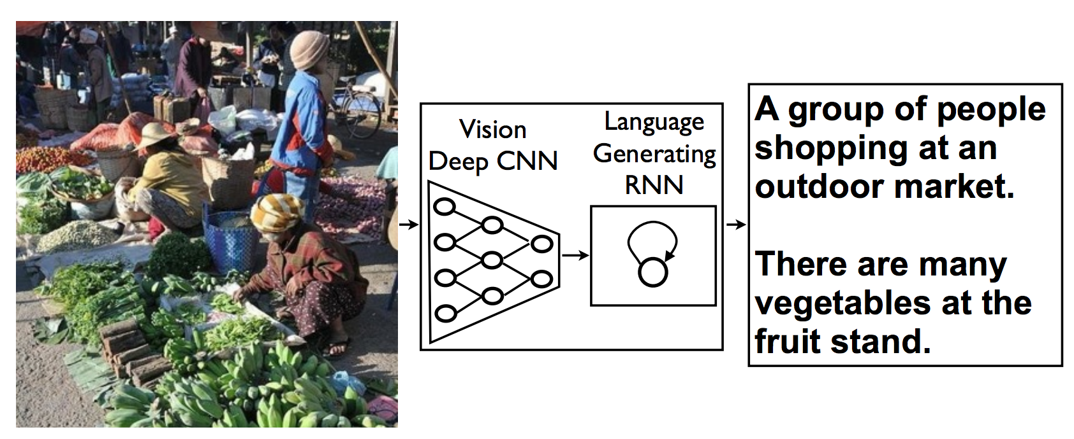
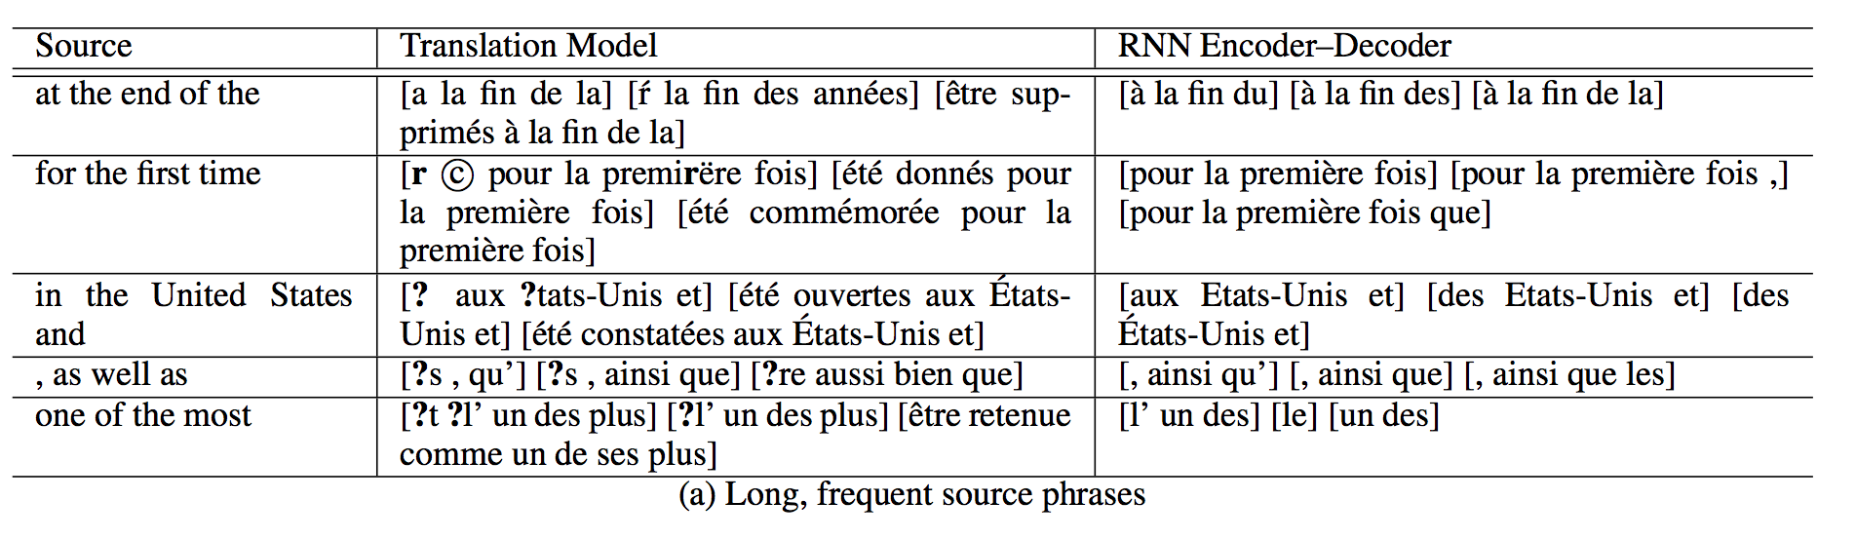
Beyond “Vision” (2)
Vinyals et al. 2016
Cho et al. 2014
Auto Encoder
Machine Translation
Notes:
Natural language Processing (NLP)

Slide 37
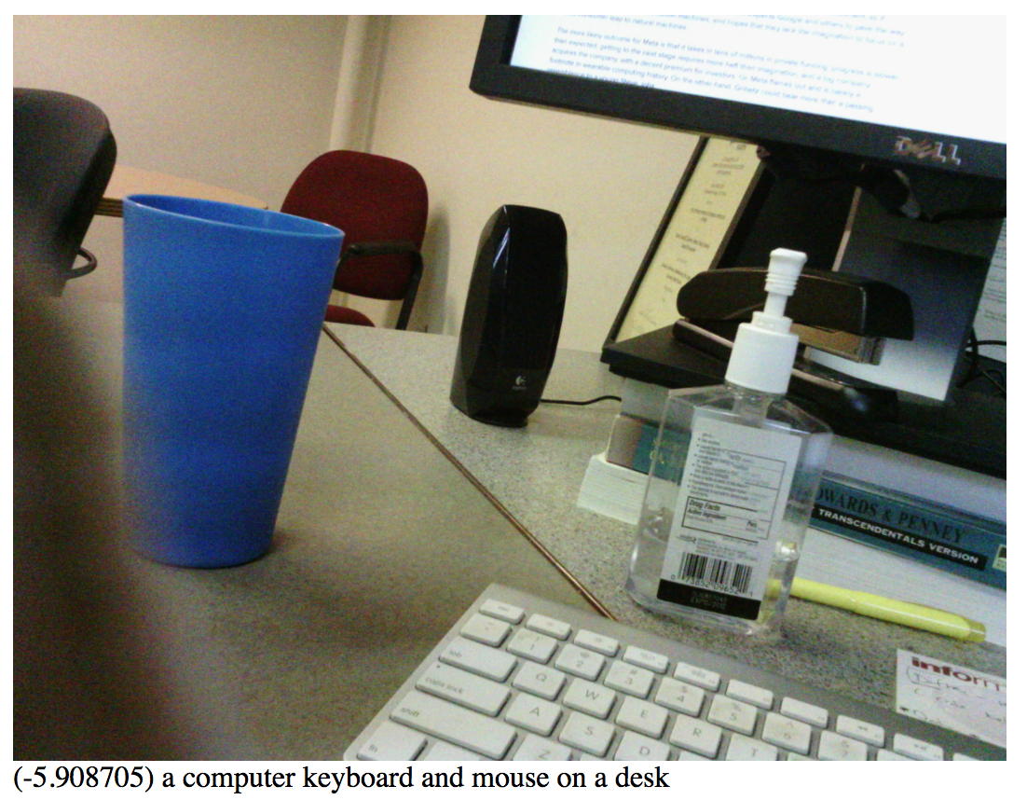
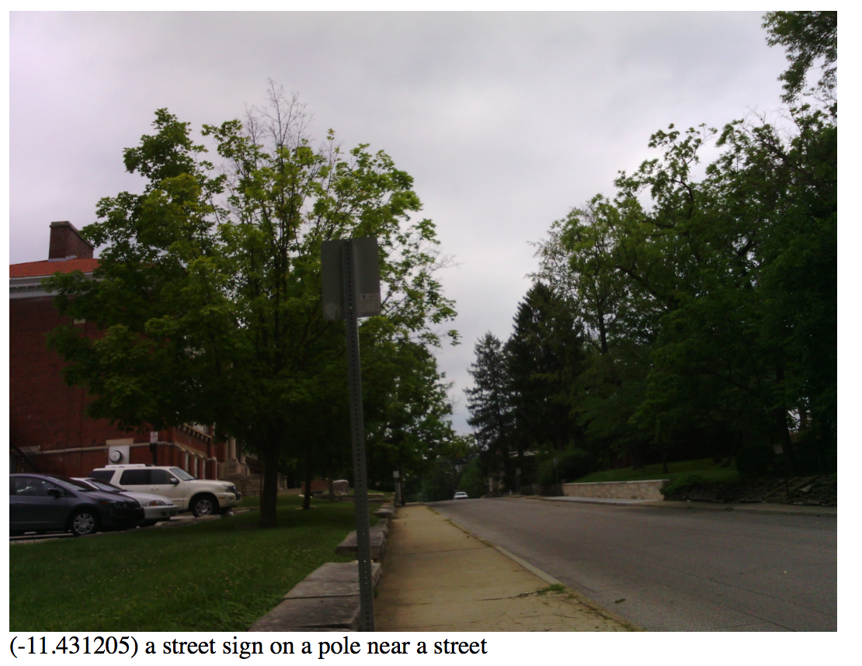
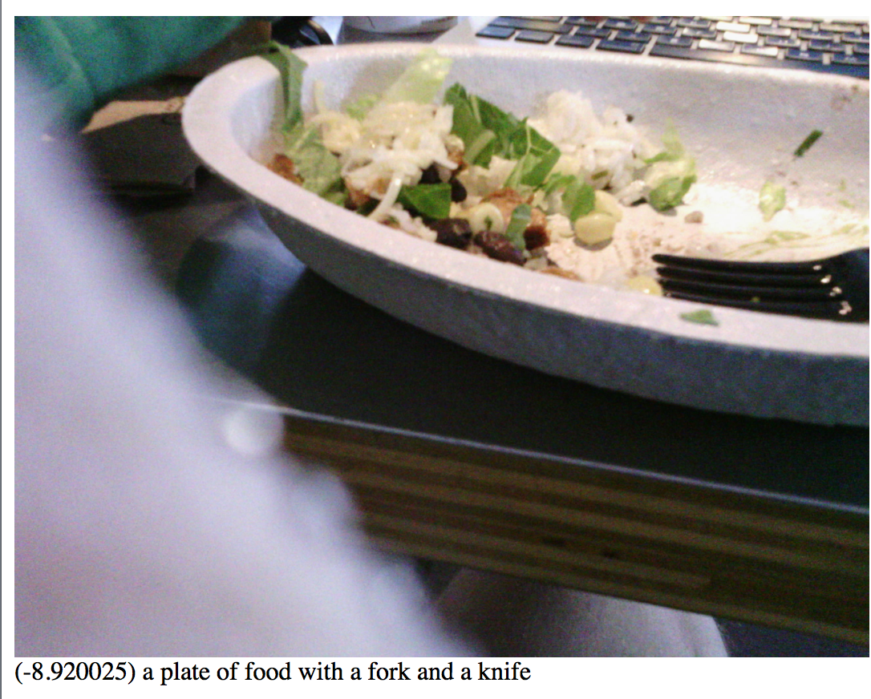
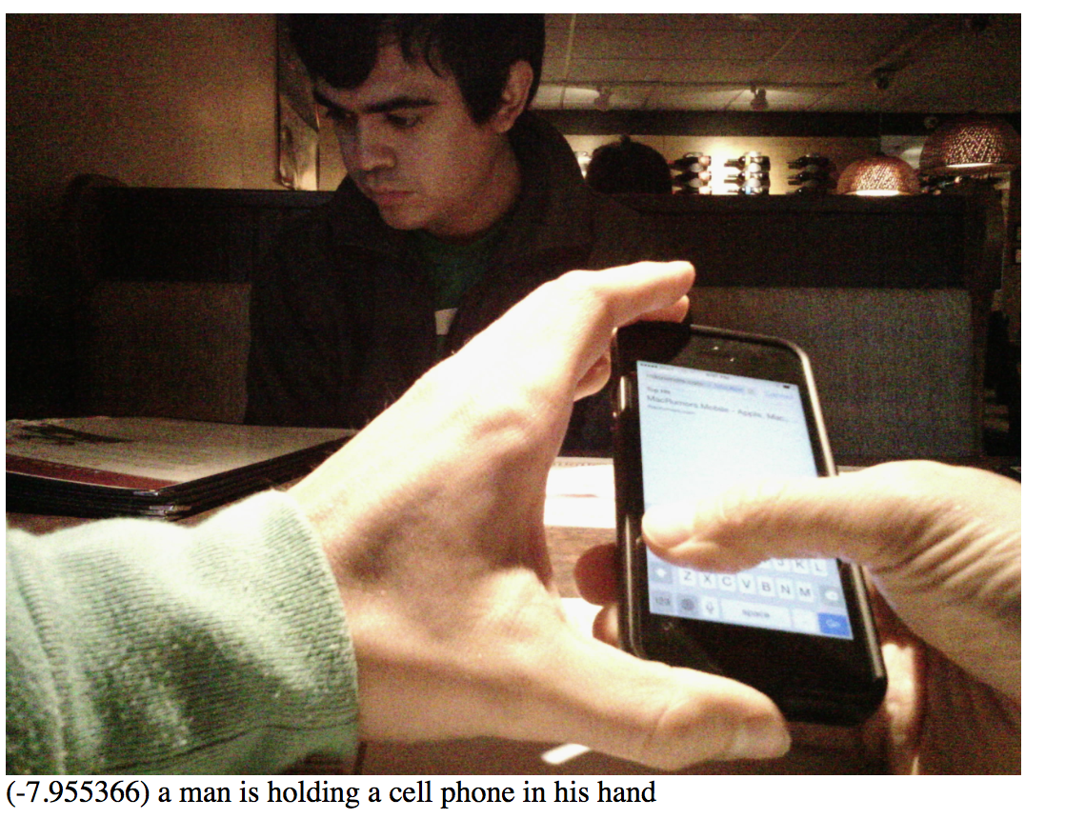
Automatic Life-Logging Captioning
Notes:
Natural language Processing (NLP)

Slide 38
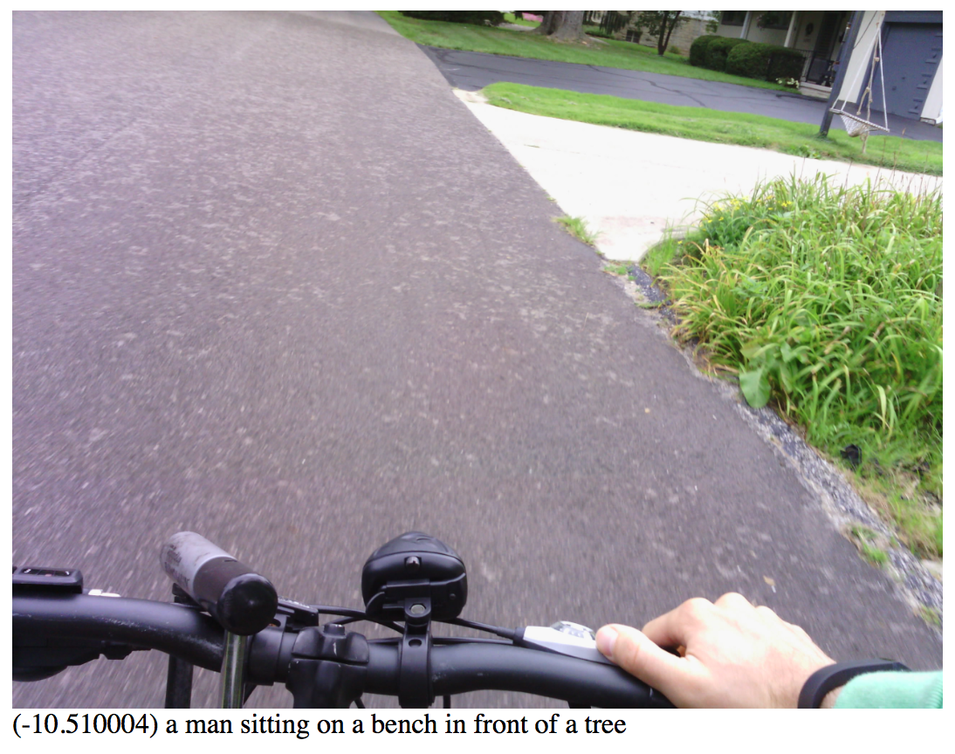
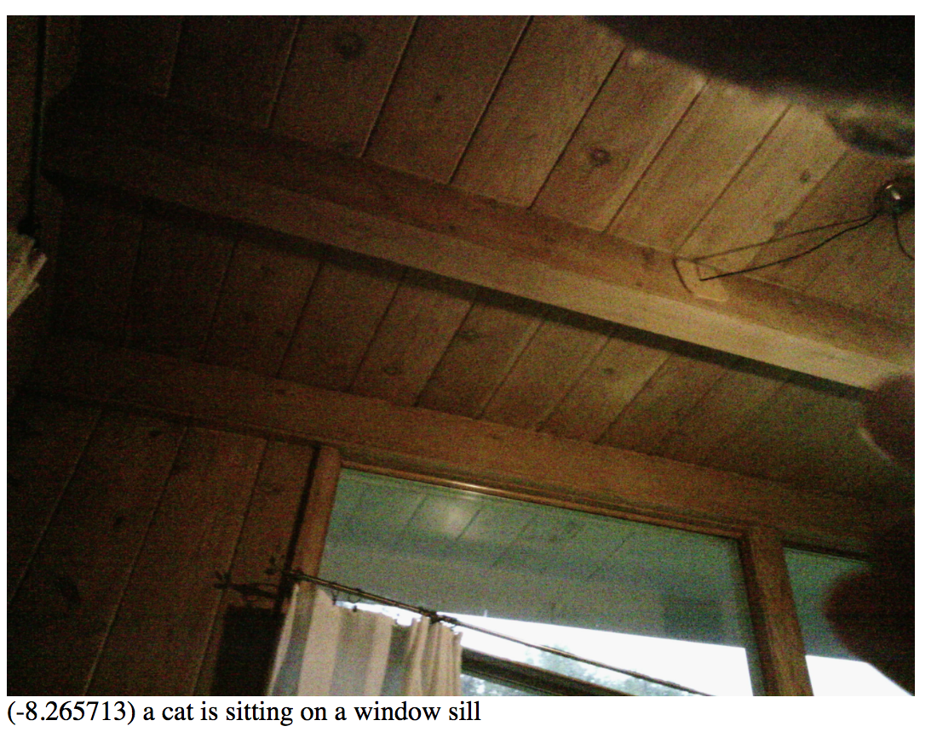
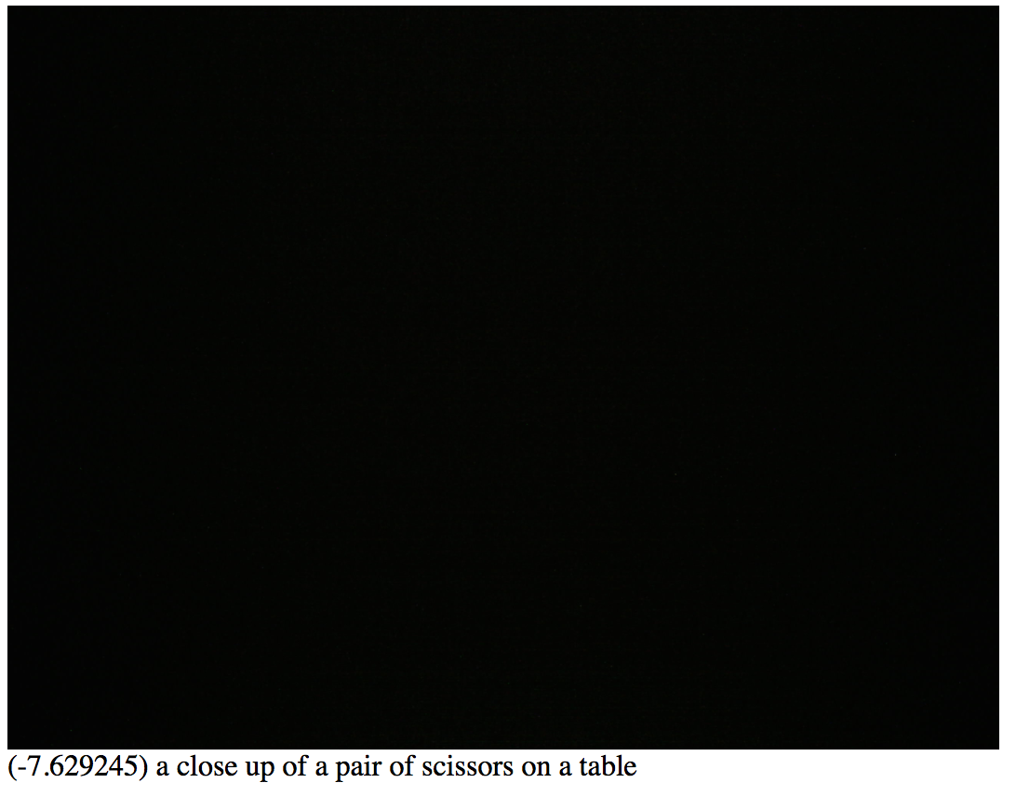
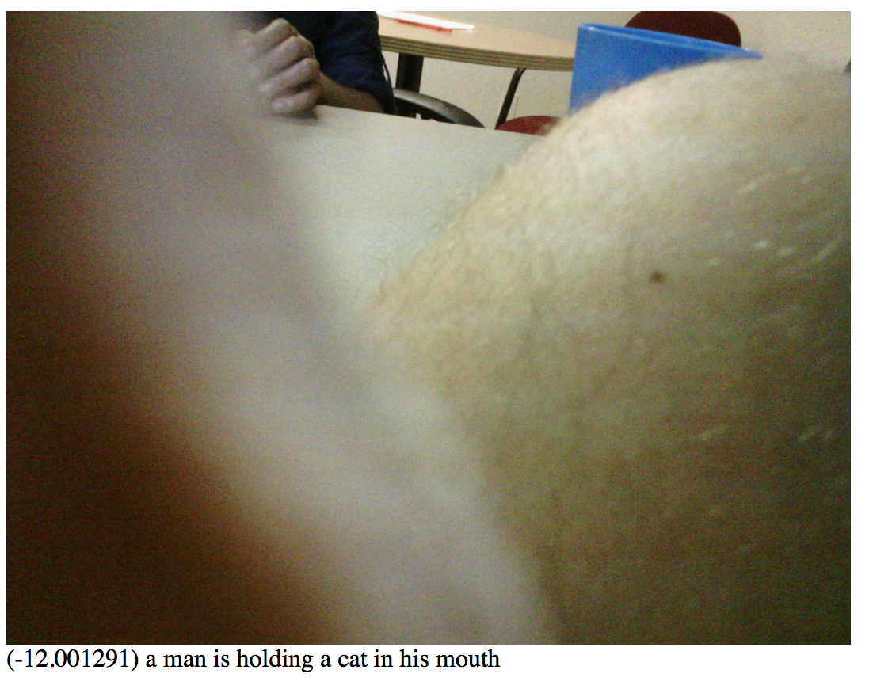
Automatic Life-Logging Captioning
Notes:
Natural language Processing (NLP)

Slide 39
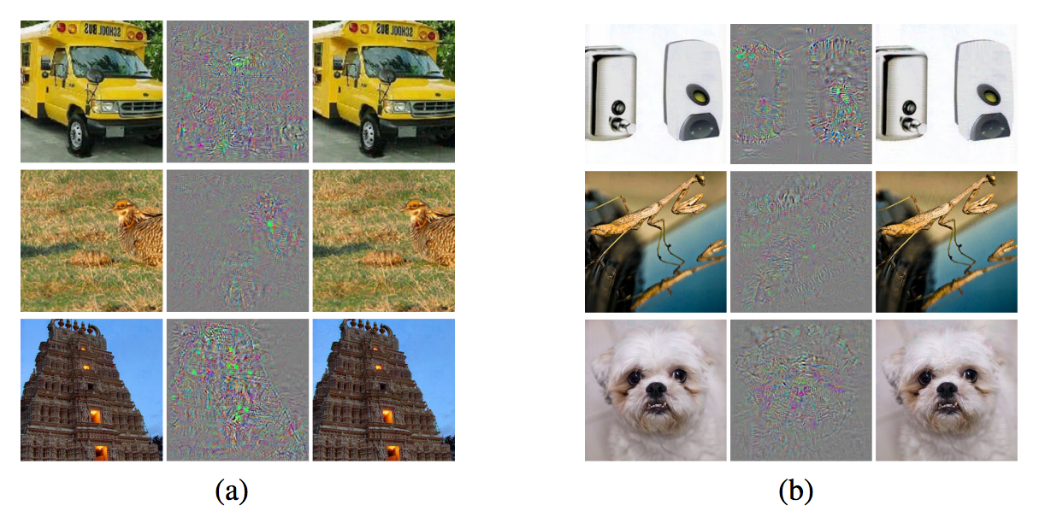
Understanding Deep Networks…
Ostrich
Szegedy et al. 2013
Notes:
Adversarial Networks

